Slide 1


CHAMPION PARENTING TO EMPOWER CHILDREN
Notes:
CHAMPION PARENTING
TO EMPOWER CHILDREN

Slide 2

TOOLS FOR PARENTS TO MAKE THEIR KIDS FEEL LIKE SUPERHEROES
Notes:
TOOLS FOR PARENTS TO MAKE THEIR KIDS FEEL LIKE SUPERHEROES

Slide 3
CHAMPION PARENTING TO EMPOWER CHILDREN
ONLINE EVENT AGENDA
THE IMPACT OF WHAT YOU SAY
  Impressionable Minds: What you say, they believe
  Communication: Intention vs Perception
  Communication: Bad Behavior vs Bad Child
  Communication: Shut Up and Listen
  Communicate for a life-long relationship
THE IMPACT OF WHAT YOU DO
  Acknowledge Your Child
  Understanding Boundaries and Rules
  Appropriate Consequences and Rewards
  Overcoming the War with Dopamine
STRATEGIES FOR EMOTIONAL HEALTH
  Celebrate Big and Small Wins
  Celebrate Failures for Their Great Lessons
  Emotional Resilience

Slide 4


THE IMPACT OF WHAT YOU SAY
IMPRESSIONABLE MINDS: WHAT YOU SAY, THEY BELIEVE

Slide 5


Positive Reinforcement
Creates Positive Results

Slide 6
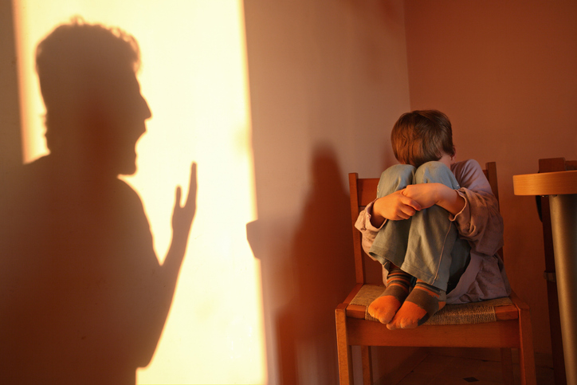
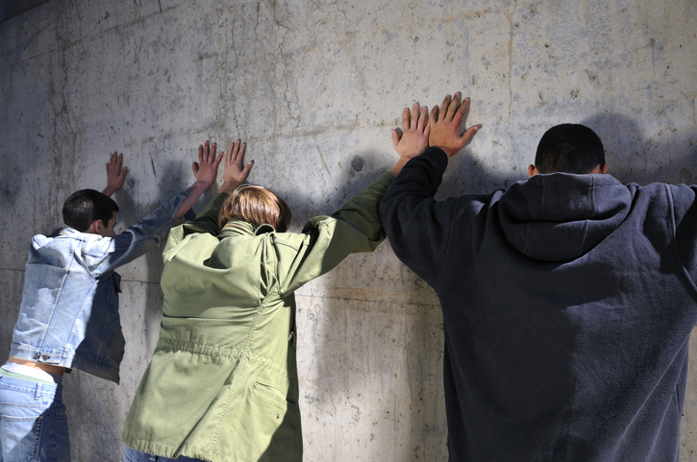
Negative Reinforcement
Creates Negative Results

Slide 7

One of my proudest parenting moments…
“Mom, I think I believe in myself so much because you have always told me that I am capable of doing or being anything that I want. You alway believe in me.”
- Elizabeth Hammer

Slide 8

Learn to be your child’s
BIGGEST FAN!

Slide 9

What you SAY
may not match
what they HEAR
THE IMPACT OF WHAT YOU SAY
COMMUNICATION: INTENTION vs PERCEPTION

Slide 10


INTENT vs PERCEPTION
WHAT YOU SAY
Stop that!
Don’t say that!
Don’t touch that!
WHAT THEY HEAR
Bad kids do that!
Bad kids say that!
Bad kids touch that!
YOUR INTENT
I want to keep you safe!
THEIR PERCEPTION
I am a bad kid!

Slide 11

Am I a bad kid?
Up to 80% of parental feedback before age of five uses negative words like stop, don’t, no, and other “negative” statements. Most, if not all, of these answers and reactions are tied to creating boundaries and rules to keep your child safe or respectful.

Slide 12
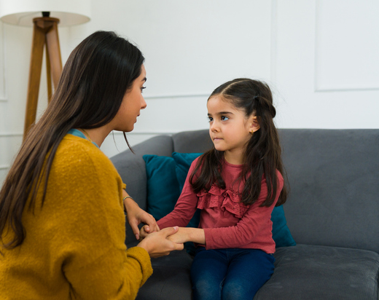
  CHILD: Mommy, am I a bad kid?
  PARENT: No, honey. Why are you asking that?
  CHILD: You always say “no” to me and tell me to “stop it.”
  PARENT: Can you, please, give me an example?
  CHILD: When riding my bike without shoes, you told me to stop.
  PARENT: I said that because you could have caught your toes in the moving parts and that would hurt you. I say that to keep your feet safe!
  CHILD: Oh! Now, I understand. Thank you, Mommy!
  PARENT: My pleasure! I love you, so I want you to be safe!
TIP: Let them get ALL of their thoughts out before you respond so they know you care about their feelings, and you understand how to respond.

Slide 13
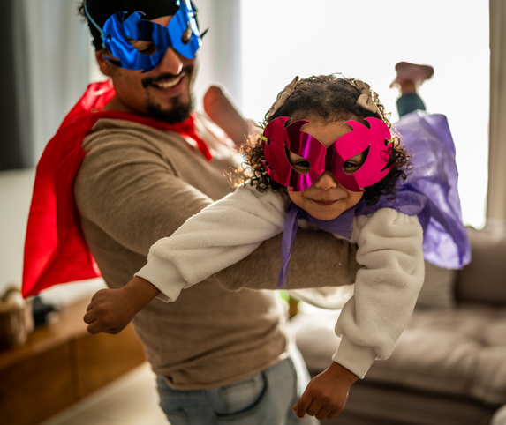
UNDERSTANDING
Is A Parent’s
Superpower!
Everyone, including adults, wants to feel validated and appreciated.
Through understanding, which is not the same as agreeing, we can create healthy, positive relationships with our children!

Slide 14
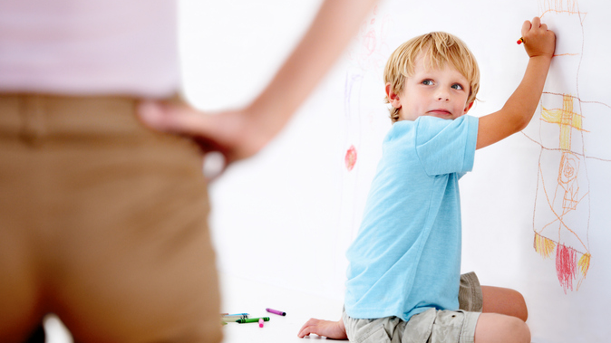
THE IMPACT OF WHAT YOU SAY
COMMUNICATION: BAD BEHAVIORS VS BAD CHILD

Slide 15

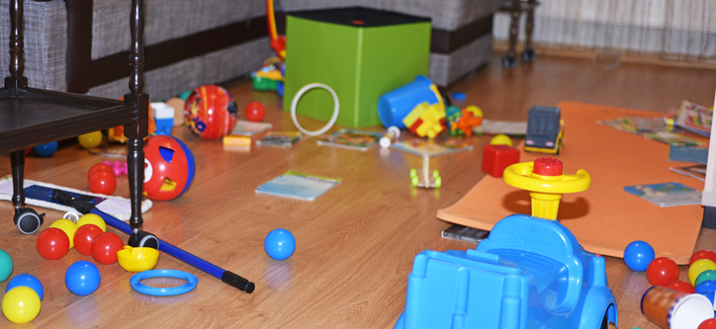
SEPARATE THE CHILD FROM THE BEHAVIOR
ACKNOWLEDGE YOUR LOVE for the child
FOCUS ON CHANGING the behavior

Slide 16

PARENT: I love you with all of my heart, and I do not like when you behave like this and leave your room messy. Do you know why?
CHILD: Because you don’t like my room messy?
PARENT: That’s right! I love you so much that I want you to live in a safe and clean room! When it is messy, someone can trip and get hurt. And everyone is responsible for cleaning up their messes.
CHILD: So, you want my room clean because you love me?
PARENT: Yes, son! That’s right! I want you to have a safe and clean home to live in!
CHILD: OK, Mommy, I’ll go clean my room!
TIP: CELEBRATE when your child understands how happy it makes you when he understands his responsibilities and the behavior doesn’t exist.

Slide 17

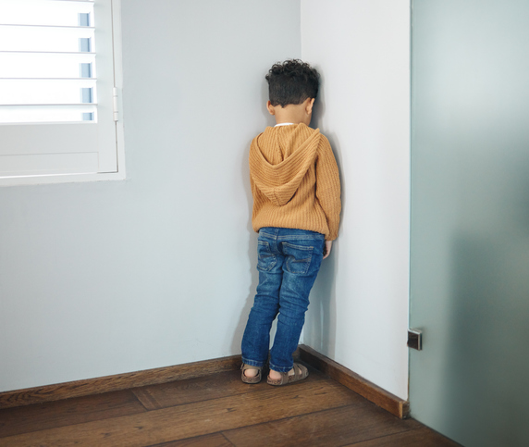
TIME-OUTS HELP BOTH PARENT AND CHILD
STOP! Take time to calm down!
PSSST…it’s OK to put yourself in time-out!
Ask the child to think
about WHY he’s in trouble.

Slide 18

TIME-OUT TIPS AND TRICKS
Use the time to calm down before speaking to your child.
Use the time to teach your child safety and manners. Ask them to think about what behavior got them in trouble.
A good rule for time is one minute for each year old they are.
Give them a visual to see how long the time-out will last.
ALWAYS take a few minutes to discuss the behavior and why it should change.
ENCOURAGE THE CHILD TO COME UP WITH THEIR OWN ANSWERS & ACCOUNTABILITY

Slide 19
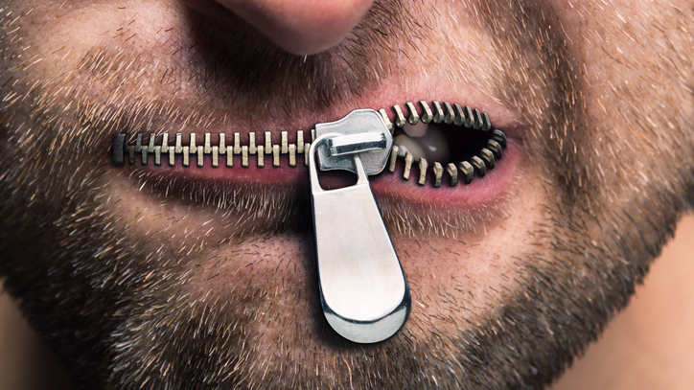
THE IMPACT OF WHAT YOU SAY
COMMUNICATE FOR A LIFELONG RELATIONSHIP

Slide 20
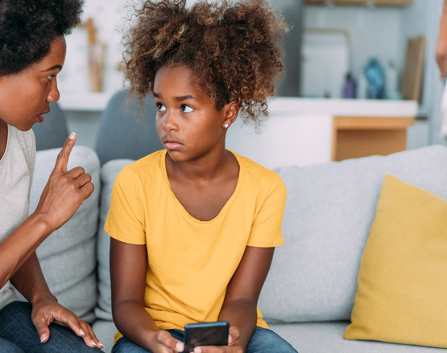
Most people are so busy thinking about their RESPONSE that they miss what is being SAID by the other person.
No matter how hard it is…
1. Shut up and listen!
2. Don’t pass judgment.
3. Create a safe place for them to tell you anything, even if it is something you don’t want to hear.
4. Praise them for telling the truth!
5. Make sure you understand what they tell you by practicing active listening.
6. After you understand them, then validate them. Example: “I understand why you feel that way.”
7. Give your response with empathy.

Slide 21

ACTIVE LISTENING
BUILDS TRUST
Repeat or rephrase what your child is saying or asking to determine if you are understanding
If your child says you didn’t understand, ask more questions about what they are asking or saying until they say that your understanding is what they are saying. This validates the child and minimizes miscommunication.
Answer the question as honestly as possible using words the child understands.

Slide 22

IF YOU DON’T KNOW THE ANSWER…
Tell them you don’t know the answer and that you will find out. Be honest!
Write the question on the whiteboard or chalkboard to acknowledge that you will answer it.
Give a reasonable day and time deadline for when you will answer. If you don’t have the answer within this period, acknowledge the question again, explain why you don’t have the answer yet, and move the deadline for answering.
Answer in terms the child understands. You may have to summarize or explain something, so ask if the child understands it. Ask if they have any more questions. Ask the child to repeat your answer so that you know if they understand. If they don’t understand, state the answer differently or more simply until they understand.

Slide 23
BUILD TRUST
THROUGH COMMUNICATION
ACKNOWLEDGEMENT builds self-esteem and self-worth for positive and negative emotions. Emotions are what they are, and we don’t have a choice about how we feel. We do have a choice about how long we feel it and how we react to it. Acknowledging the emotion is acknowledging the child, and this makes them feel heard and understood, which are essential for feeling loved.
HONEST FEEDBACK is not judgmental, it is essential in building trust and maximizing a learning experience. Remember that learning is built upon a base. The stronger and more reliable the base, the stronger the structure.
POSITIVE REINFORCEMENT feeds positive emotions and builds the child’s self-worth and confidence. This starts early on, and becomes critical as the child grows, and is challenged with more complicated decisions. This also feeds dopamine production which is the “feel good” hormone. When children rely upon positive reinforcement from parents and other loving family and friends, they are less likely to be controlled by social media and other outside influences that may not be in your child’s best interest.
COMMUNICATION SETS UP
YOUR LIFELONG RELATIONSHIP
Children rely upon their parents and adults to learn everything including emotions. Adults must be diligent in providing acknowledgment, honest feedback, and positive reinforcement.

Slide 24
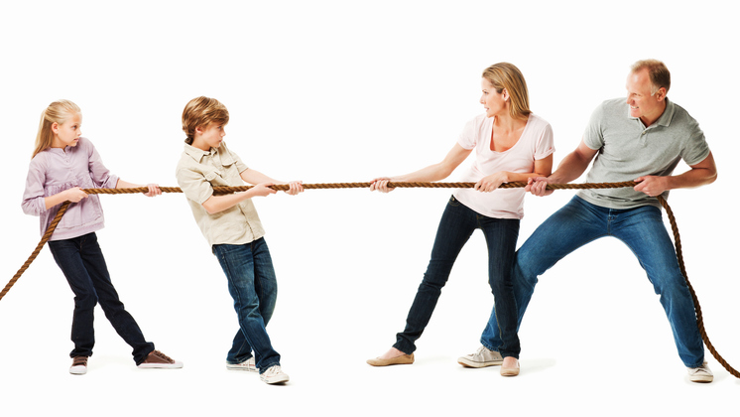
Do you want to be right, or do you want to know what is going on with your kids?
When you get into a communication tug-of-war with your kids, EVERYONE LOSES!

Slide 25

When communication goes wrong… everyone feels bad.

Slide 26
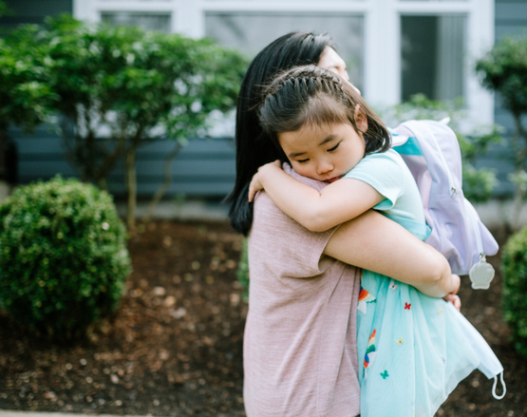
When communication
goes well…
people feel validated and loved!

Slide 27
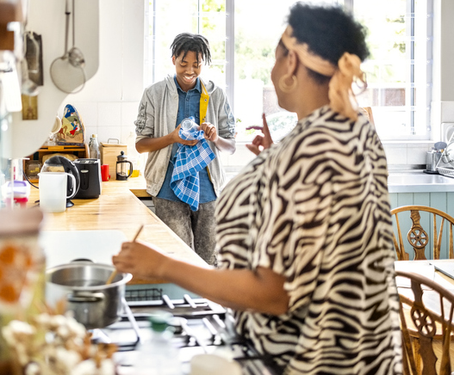
THE BENEFITS OF OPEN COMMUNICATION EARLY ON SUPPORTS BETTER COMMUNICATION WHEN YOUR KIDS ARE OLDER
Be the communicator your teenager needs by being a
safe and open communicator when they are young.

Slide 28

THE IMPACT OF WHAT YOU SAY
Healthy communication sets up your lifelong success for your relationships!

Slide 29
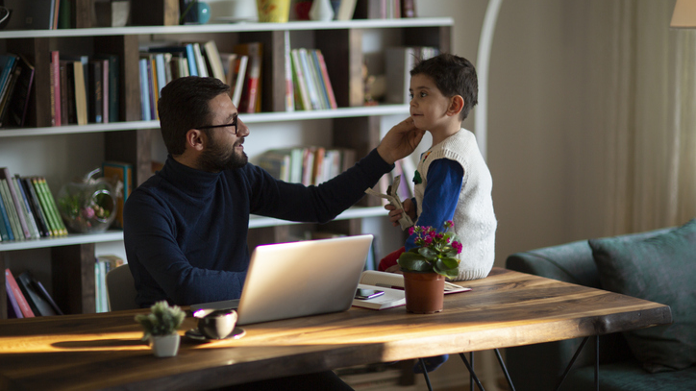
THE IMPACT OF WHAT YOU DO
ACKNOWLEDGE YOUR CHILD

Slide 30

When you IGNORE your children, they feel UNLOVED and UNIMPORTANT.

Slide 31
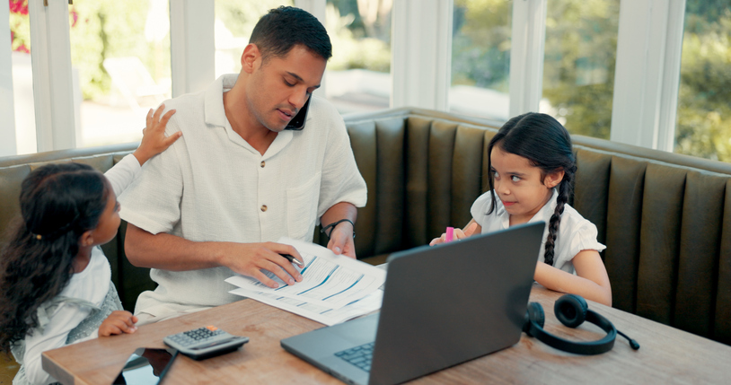
Ignoring them sets everyone up for failure.

Slide 32
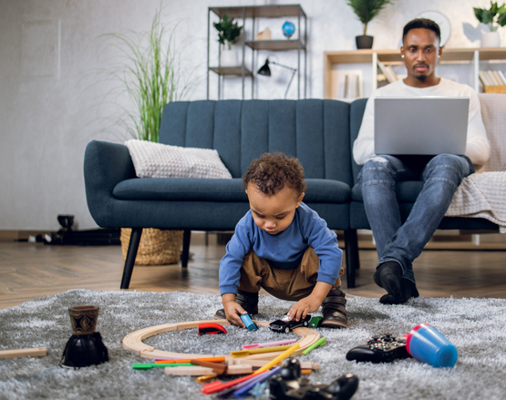
GIVE THEM SOMETHING TO DO NEXT TO YOU.
They want to be near you because they love you!

Slide 33

GIVE THEM SOMETHING SIMILAR TO DO!
If you give them something similar to what you are doing, it makes them even happier. They want to be like you because they love you!

Slide 34

Curious Child’s Questions
Why do ants live in holes?
Why is the sky blue?
Why do I have to wear shoes when I ride my bike?
Why do I have to keep my elbows off the table?
Why do I need to play with the new kid in school?
Why do I have to tie my shoelaces?
Am I a bad kid?
YOUR QUESTIONS ARE
IMPORTANT BECAUSE
YOU ARE IMPORTANT
When you can’t answer, validate the child by writing down the question.

Slide 35
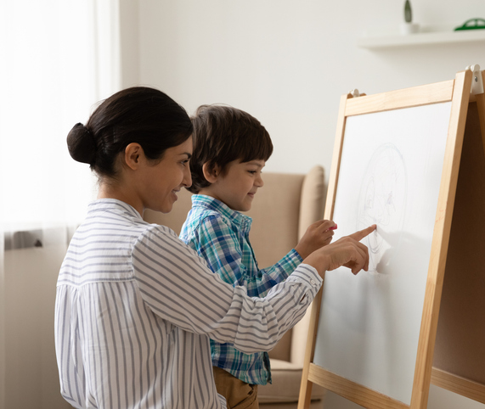
SOLUTION WHEN
YOU HAVE
LIMITED TIME
Write down the question to validate child’s importance.
Tell child you will answer the question when you aren’t cooking dinner, working, or whatever keeps you from having time to answer.
Always go back to answer the question. You can start with, “Son, do you still have questions about…?”
If you don’t know the answer, it’s okay. Find the answer, and then answer.
Always answer truthfully, consistently, and within a reasonable amount of time.

Slide 36
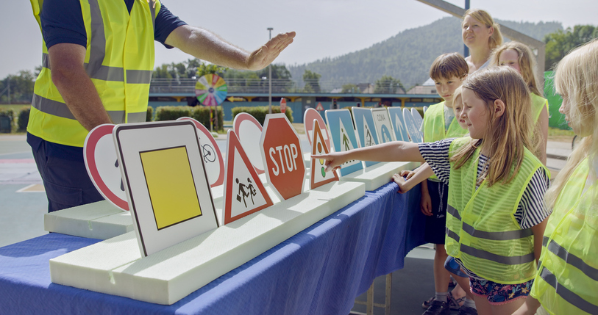
THE IMPACT OF WHAT YOU DO
UNDERSTANDING BOUNDARIES AND RULES

Slide 37
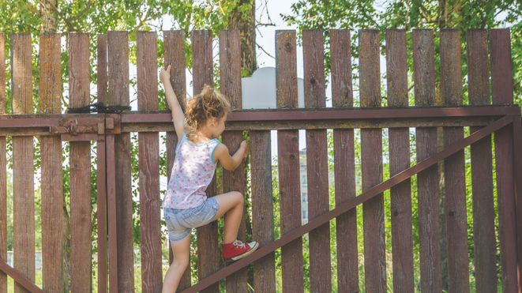
UNDERSTANDING CHANGES PERCEPTION
Children are smart. When you help them understand boundaries and rules,
they are more likely to follow them and avoid negative self-beliefs.
SAFETY
Hot surfaces can burn you
Being by cars that are much bigger than you can hurt you
Riding your bike in the street can hurt you
Talking to someone you don’t know can let them hurt you
RESPECT AND MANNERS
Talk nicely to others so they will like to hear what you say
Call adults Sir, Mr., Ma’am, Mrs., or Miss to show them they are special
When you interrupt someone when they are talking, it makes them feel unimportant

Slide 38

DON’T climb on that fence! vs
When you climb on fences, you can fall and get hurt.

Slide 39
Turn I’M BAD into I UNDERSTAND
I’M BAD STATEMENTS
Don’t play with that!
Don’t say that!
Stop jumping on the bed!
Don’t hit your sister!
Don’t talk to me like that!
I UNDERSTAND STATEMENTS
That belongs to Daddy. Please play with your toys.
When you say that, it hurts your friend’s feelings.
When you jump on the bed, you can fall and get hurt.
When you hit your sister, it hurts her feelings and body.
When you talk to me like that, it makes me feel bad.
When the child understands the consequences of the behavior, such as getting hurt
or hurting someone’s feelings, they understand why the boundaries or rules exist.

Slide 40

Ask The Child
Which Type of Rule or Boundary It Is
GIVE THEM TIME TO THINK, THEN
PARENT: Do you know why you shouldn’t cook when Mommy isn’t with you?
CHILD: Because I could get burned or start a fire?
PARENT: Yes! Very good! So, why does this rule exist?
CHILD: To keep me safe?
PARENT: That’s right! Good job, sweetheart!
TIP: Celebrate the correct answer!

Slide 41

THE IMPACT OF WHAT YOU DO
APPROPRIATE REWARDS AND CONSEQUENCES

Slide 42

DEFINE THE BOUNDARIES AND RULES TOGETHER
AS A FAMILY
Define the rewards and consequences so everyone in the family has the same expectations.

Slide 43

SET UP YOUR FAMILY FOR SUCCESS
Be CONSISTENT.
Make sure the rewards and consequences are APPROPRIATE.
Be DISCIPLINED. Sticking to the agreed-upon consequences can be hard on kids and parents.
CELEBRATE YOUR CHILD’S WINS!
TIP: APPROPRIATE REWARDS show appropriate value. Don’t SPOIL!

Slide 44

INVOLVE EVERYONE WHO SPENDS TIME WITH YOUR CHILDREN
AS THEY SAY…
It takes a village
to raise a child
TIP: Keep boundaries, rules, rewards, and consequences the same wherever your child goes.

Slide 45

THE IMPACT OF WHAT YOU DO
OVERCOMING THE WAR WITH DOPAMINE

Slide 46

CHILDREN ARE ACTUALLY ADDICTED TO DOPAMINE
The brain’s reward center releases a “feel good” chemical called DOPAMINE. This is linked to pleasurable activities such as food, social interaction…
and social media because of its reinforcing nature.

Slide 47
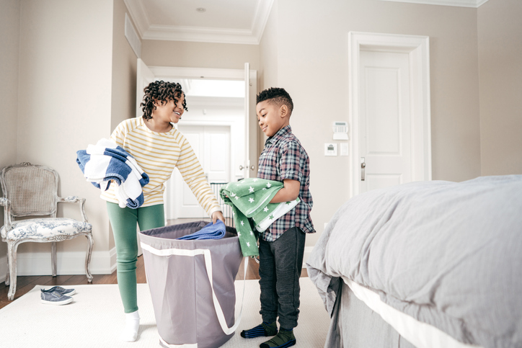
EXPAND REWARDS TO STIMULATE DOPAMINE
Instead of DO THE LAUNDRY…
Collect the dirty clothes
Wash the clothes
Dry the clothes
Fold the clothes
Put the clothes away
You have just increased from 1 to 5 REWARDS!

Slide 48
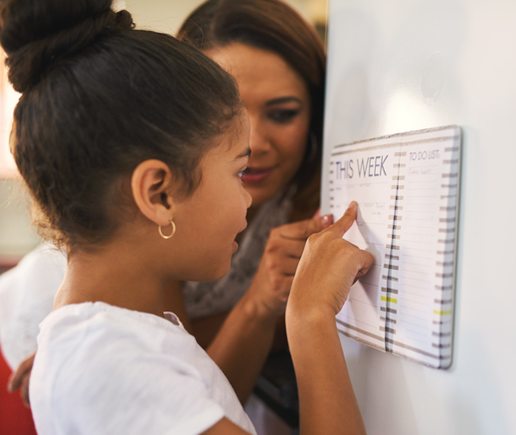
STEPS FOR
WINNING THE
DOPAMINE WAR
Put the RESPONSIBILITIES & REWARDS LIST where everyone can see it.
ACKNOWLEDGE THE ACCOMPLISHMENT soon after it is completed to show it is important and your child is appreciated.
CELEBRATE your child’s accomplishments!
TIP: Teach your child to do chores how you want them done so
you are CELEBRATING and not criticizing what they accomplish.

Slide 49

STRATEGIES FOR EMOTIONAL HEALTH
CELEBRATE BIG AND SMALL WINS

Slide 50

For small children, every big or small win is important to their self-esteem.
Every celebration is a dopamine hit that supports relationships instead of electronics.
Acknowledgements makes them feel loved, builds their self-esteem, and teaches them the “good consequences” of good decisions and behaviors.
Children want your attention. If you give them attention for good behavior, they will strive for good behavior.
If you only pay attention when they do something bad, they will behave badly.
CHILD: Mommy, I tied my shoes all by myself today!
PARENT: Great job, honey! You are such a talented girl!

Slide 51
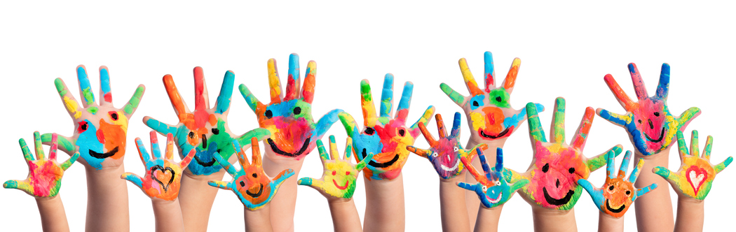
Affordable CELEBRATION Ideas
SMALL WINS:
High-fives
Special Handshake
Song with Positive Lyrics
Dance of Child’s Choice
BIG WINS:
Focused Time with Parent
Earn Points toward a Prize
Special Dinner of Their Choice
Special Activity of Their Choice

Slide 52
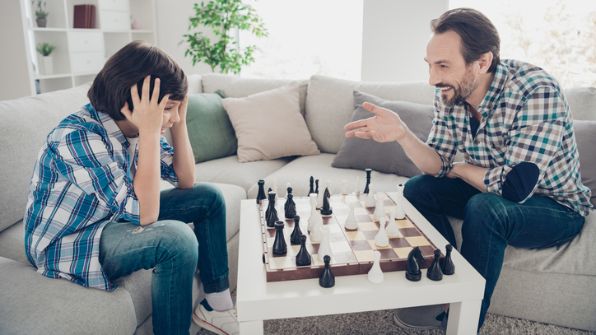
STRATEGIES FOR EMOTIONAL HEALTH
CELEBRATE MISTAKES FOR THE LESSONS

Slide 53
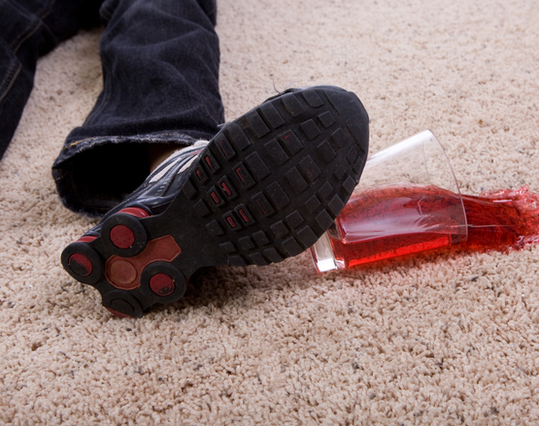
Every mistake is an opportunity to learn!
Teaching kids to find the lesson in or the positive side of their mistakes can make one of the most significant differences in their emotional health for the rest of their lives!
CHILD: Mom, I spilled my punch on the carpet!
PARENT: Awesome! You get to learn how to clean the carpet and to understand the rules better! Woohoo! It’s a new opportunity to learn!

Slide 54

CELEBRATING mistakes and failures helps children grow!
GRATITUDE:
What is the good side?
How did you improve?
What did you learn?
How can you choose better next time?
IMPROVES SKILLS & KNOWLEDGE:
Did you learn to perform better?
Will you learn to improve your grade?
Did you learn to improve your team?
Did you learn new strategies?
Lessons are beneficial even when they hurt. Noone became stronger from easy times!

Slide 55

When you help children see the good in situations, they learn to go from negative to positive emotions.
Finding GRATITUDE for both good and bad situations builds EMOTIONAL STRENGTH.
The habit of turning TRAGEDIES into TRIUMPHS is a SUPERPOWER!

Slide 56
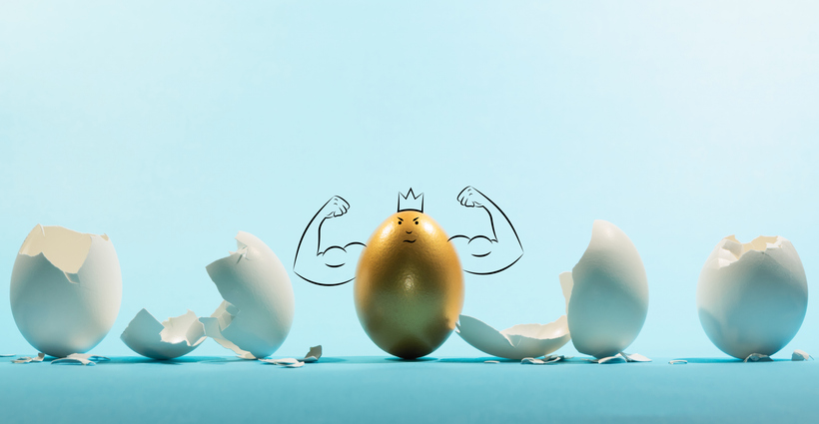
STRATEGIES FOR EMOTIONAL HEALTH
EMOTIONAL RESILIANCE

Slide 57

EVERY Child Left Behind
Loss of recognition for excelling
No consequences for poor results
Every child treated the same—everyone gets a ribbon or award
LOWERED STANDARDS so everyone can pass, which disincentivizes all children
No accountability, good or bad
Kids are taught to pass assessments, not taught to LEARN
Children are assessed an average of 112 times from Kindergarten through High School
RESULT:
CHILDREN ARE NOT PREPARED FOR LIFE’S UPS AND DOWNS

Slide 58
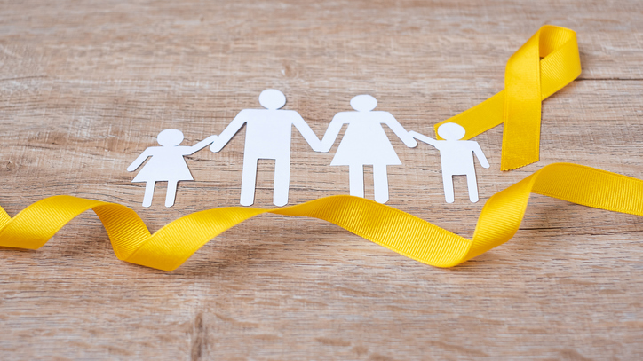
According to the CDC:
Suicide is the 2nd leading cause of death for ages 10-14
Suicide is the 3rd leading cause of death for ages 15-24
Until we teach children to FAIL and be EMOTIONALLY RESILIENT,
these shocking statistics are unlikely to improve.

Slide 59

Have you created your life based on what people said to you as a child?
How much of what was said is true?
What beliefs do you have that hold you back?
What beliefs do you have that make you shine?

Slide 60
INPUT determines OUTPUT
child
Positive Feeling
Neutral Feeling
Negative Feeling
ADULTS are a combination of beliefs from positive and negative impressions where emotions are attached to the experiences.

Slide 61

FEELINGS are not right or wrong.
Teach children that their emotions are important and there are no “wrong” emotions.
Emotions are a natural reaction to circumstances. They are what they are. How we
manage our emotions is essential to developing healthy emotions and emotional resilience.

Slide 62
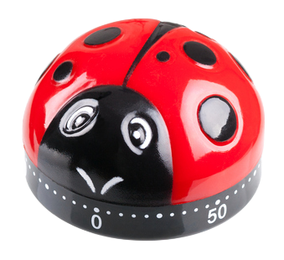
ACKNOWLEDGE, DISCUSS, & REDIRECT
THIS TECHNIQUE IS FOR YOUNG CHILDREN WHO ARE STILL LEARNING ABOUT DIFFERENT EMOTIONS.
ACKNOWLEDGE the natural feeling/emotion.
DISCUSS why your child feels that way.
REDIRECT to a more positive feeling.
CELEBRATE the new positive feeling!
CHILD: I’m really angry!
PARENT: I understand why you feel that way. If Johnny made you that angry, let’s not give him more than two minutes of your day. OK?
CHILD: OK, I’m will be really mad for two minutes!

Slide 63
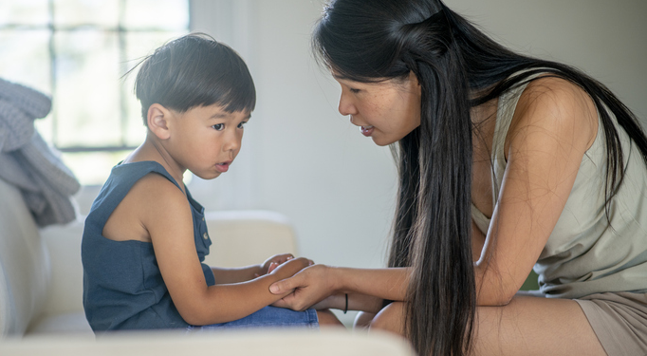
PRACTICE ACKNOWLEDGE, DISCUSS, AND REDIRECT WITH YOUR CHILDREN
Practice this with young children who feel negative emotional reactions like “angry” and “sad.”
Identify the name of the emotion so your child learns to identify the emotion. Have a conversation about that emotion so that your child and you both understand what the feeling is. You may find your child feeling more than one emotion in this conversation. Focus on the strongest emotion for the exercise.
Identify the emotion as a “negative” emotion with no judgment of it. A negative emotion feels sad or bad.
Acknowledge that the emotion is okay and give a time limit for them to feel it by saying something like, “It is fine to be angry, so you can feel that for two minutes, and then we are going to move on.”
Set the timer for an agreed amount of time (2-4 minutes) and encourage the child to fully feel the emotion for the entire time like “Now, feel angry at Johnny for this whole time, then we will let it go!” Do not interrupt this process for any reason – this is a short time and the emotion is acknowledged as valid.
When the time is completed, ask the child which “good” emotion they want to feel now. At the beginning of this learning experience, you may need to suggest one like “forgiving” or “loving.”
Once the child chooses the positive emotion, reinforce it by having the child (or you) write “I AM FORGIVING” on the whiteboard or chalkboard. If this emotion corresponds to a sticker or wearable button, place it on the child’s clothing to wear for the day.

Slide 64
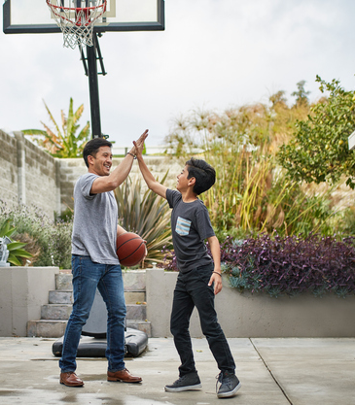
INTERRUPT, REPLACE,
AND CELEBRATE
THIS TECHNIQUE IS FOR OLDER CHILDREN WHO ALREADY UNDERSTAND DIFFERENT EMOTIONS.
INTERRUPT the negative emotional feeling by jumping up, yelling, or by doing something physically dramatic.
REPLACE with a positive feeling.
CELEBRATE the new positive emotion!
TIPS:
Practice this 5 times for each bad emotion you feel.
Practice this ON PURPOSE to train your emotional reactions! (feel bad, interrupt, replace, celebrate)

Slide 65

ACKNOWLEDGE AND CELEBRATE POSITIVE EMOTIONS
USE THIS TECHNIQUE FOR POSITIVE EMOTIONAL REACTIONS SUCH AS “EXCITED” AND “POWERFUL”:
IDENTIFY the name of the emotion so your child learns to identify the emotion and that the emotion as a “good” emotion.
ACKNOWLEDGE the emotion and that it is good by restating how the child feels so that the child knows you understand how he or she feels like, “You feel excited that you got an ‘A’ and that is good!”
CELEBRATE all good emotions with clapping, high-fives, and other appropriate positive behaviors.

Slide 66
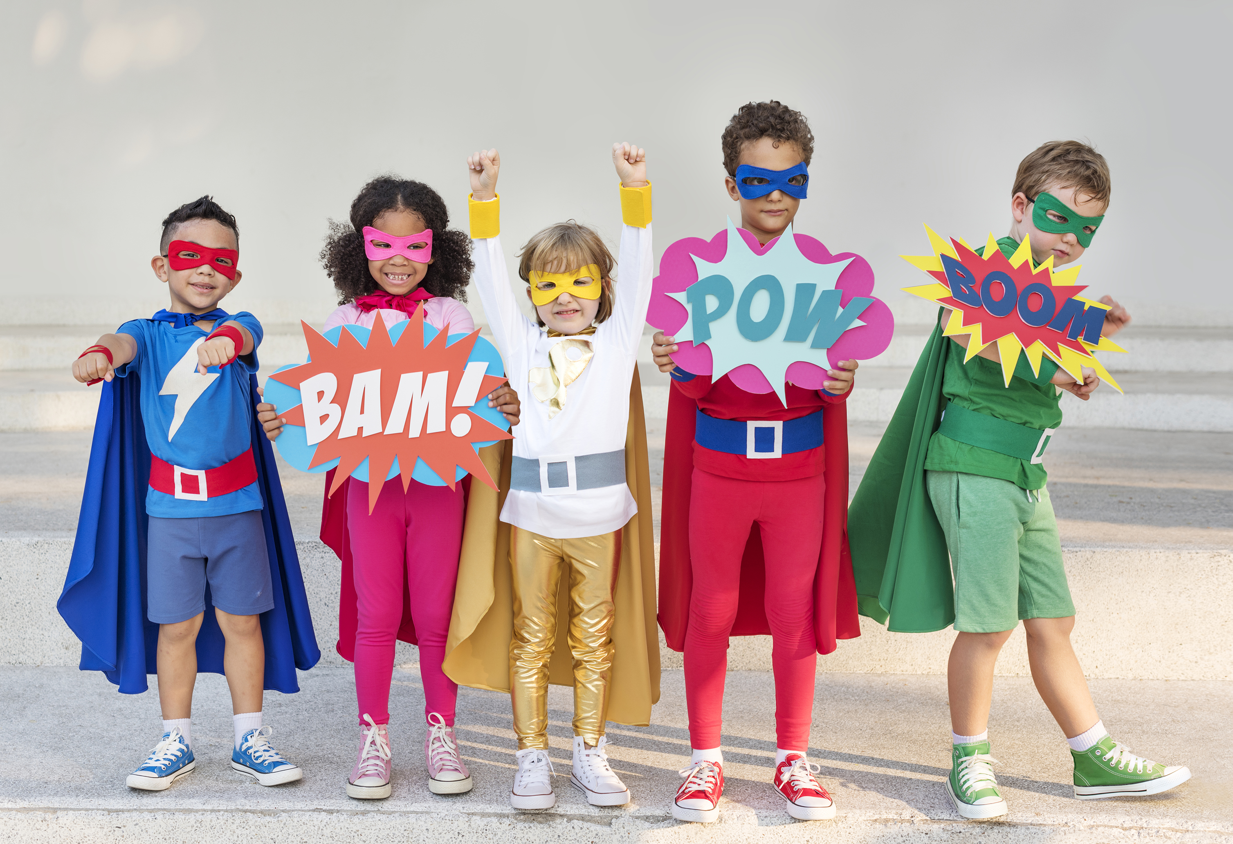
EMOTIONAL RESILIENCE
  SUPERHEROS HAVE A CHOICE ABOUT THEIR EMOTIONS
  Once your child understands there is a choice between staying in a negative emotion or replacing it with a positive emotion, they are empowered to be happier in life.
  EMOTIONAL RESILIENCE, when practiced so much that it becomes natural, will allow your child to get through good times with grace and bad times with strength and agility. It reduces drama and trauma and creates stable emotional health.

Slide 67
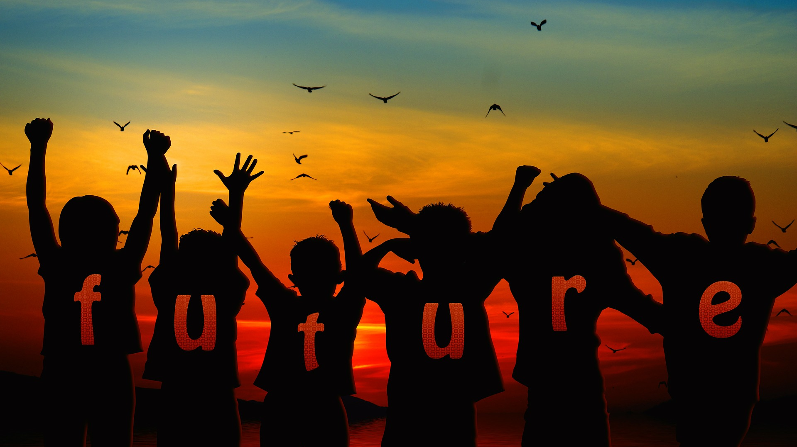
CHILDREN ARE OUR MOST VALUABLE ASSET
The HEALING of our world will come from them.
Give them the tools of self-esteem and emotional resilience
so they can succeed in their futures and ours!

Slide 68
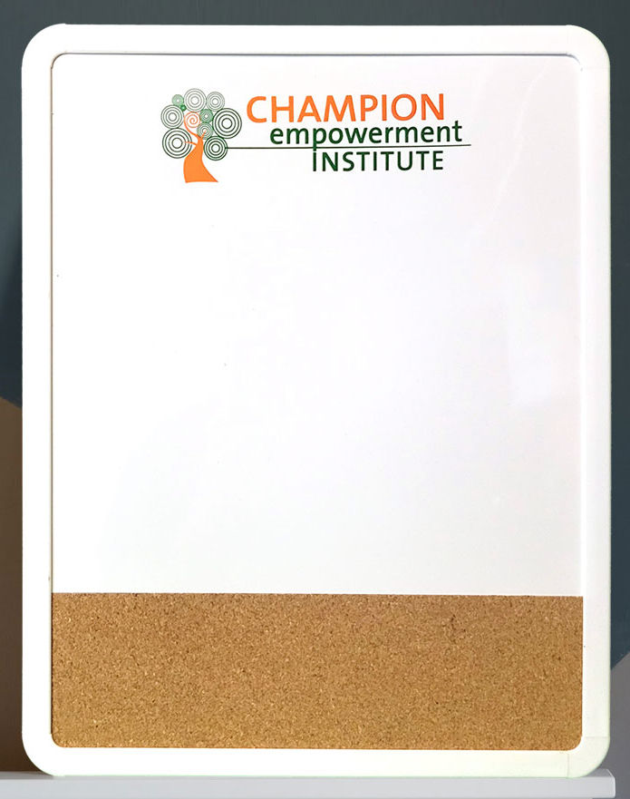
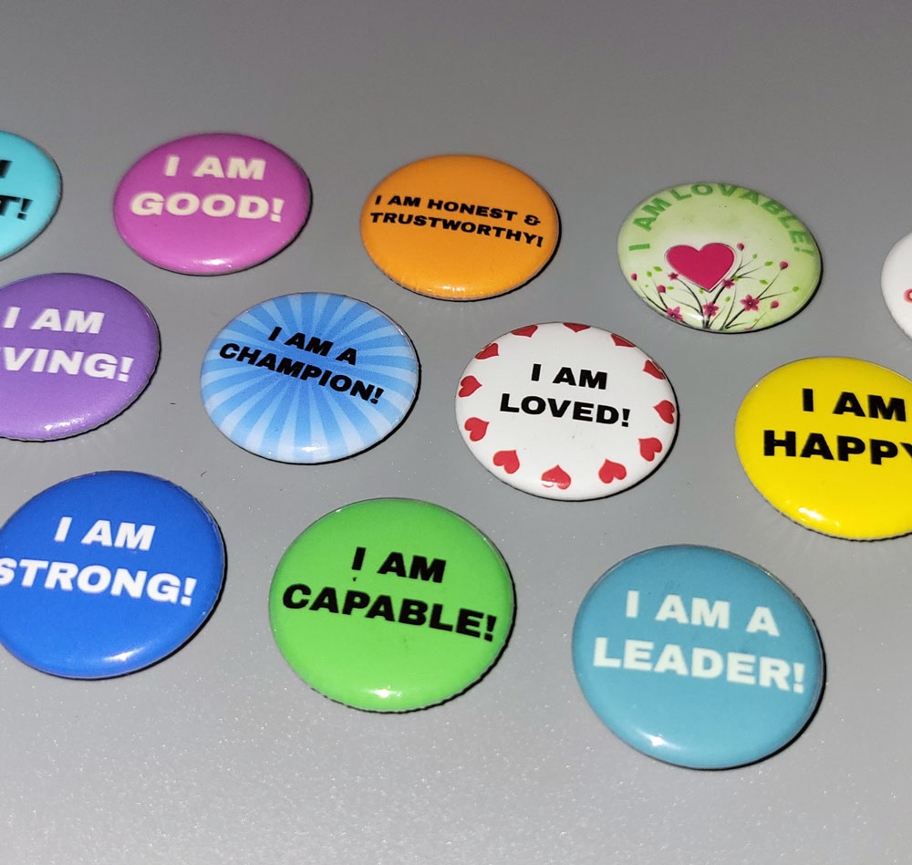
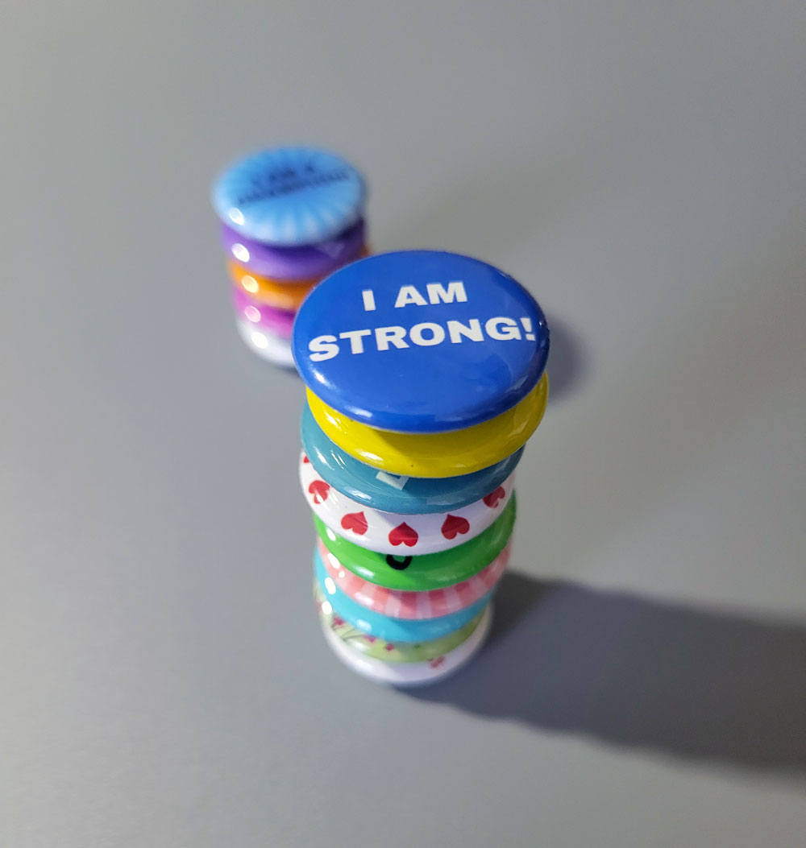
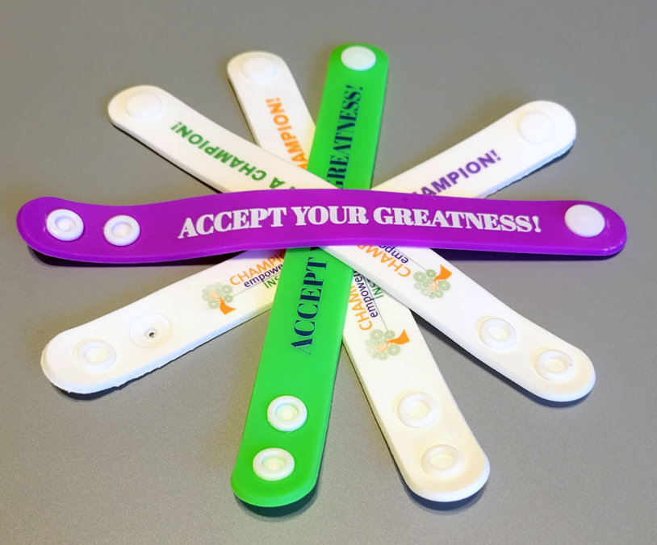
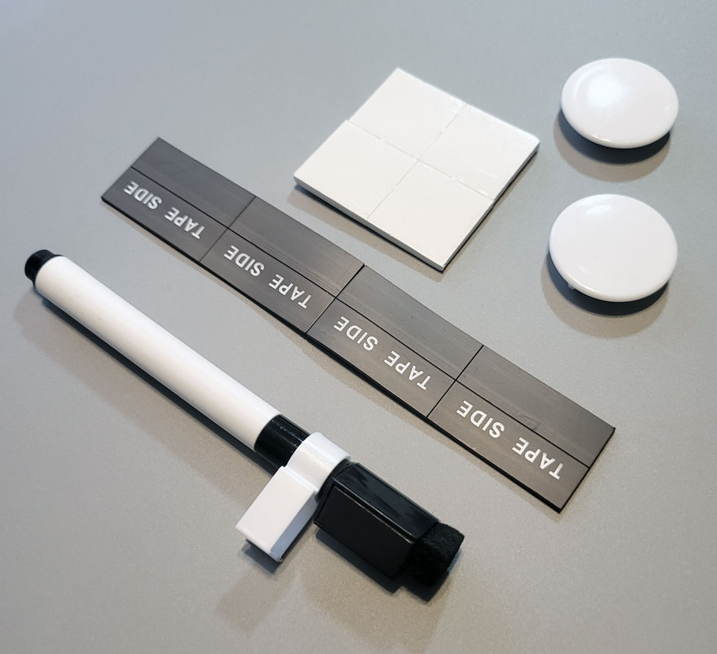
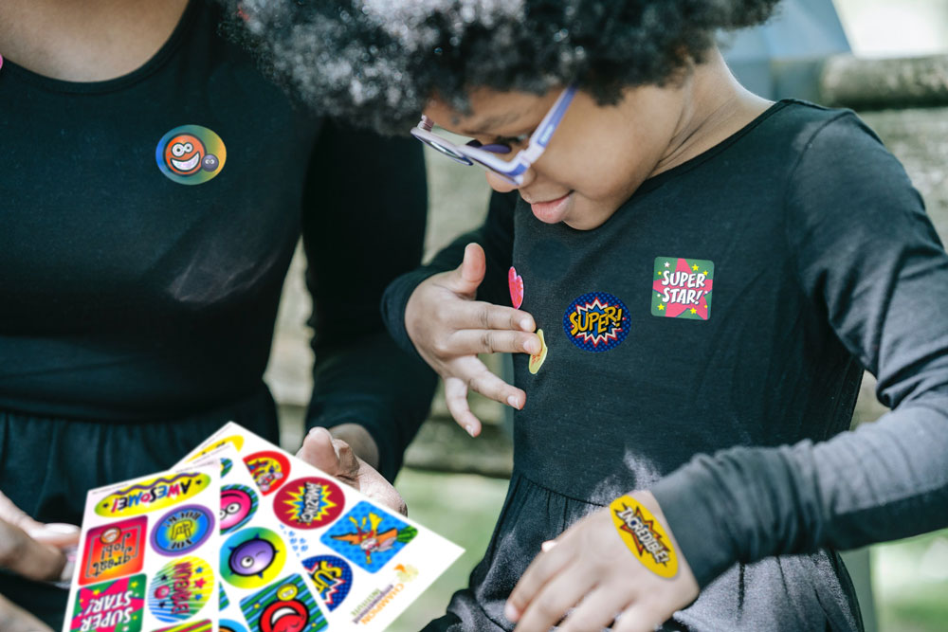

Champion Parenting to Empower Children
TOOL KIT INCLUDED! A $100 RETAIL VALUE!
1.
2.
Magnetic whiteboard with cork.
Magnetic buttons for surfaces or wearing.
Positive quotes and rewards stickers.
Positive affirmation wristbands energized to support focus, positive thoughts, and energy management. (Two included.)
3.
4.

Slide 69
PREMIUM MEMBERSHIP OFFERS FOR ATTENDEES
PREMIUM MEMBERSHIP $199 $477
PREMIUM PAYMENT PLAN $249 $477
$49 DOWN PLUS $50 A MONTH FOR 4 MONTHS
INCLUDES:
Unlimited calls with our Student Loan Solution Mentors
Unlimited access to our financial literacy and life skills courses
30% discount to in-person events
50% discount to online events
Unlimited access to member discounts
www.ChampionEmpowerment.com
Champion Empowerment Institute (est. 2013) offers foundational concepts and education about finances, budgeting and life skills to empower people to enhance their lives and develop financial freedom.

Slide 70

CHAMPIONS EMPOWERMENT INSTITUTE, LLC
Crawfordville, Florida 32327
Solutions@ChampionsCompanies.com
www.ChampionEmpowerment.com
©2024 Champion Empowerment Institute
All Rights Reserved
CHAMPIONS COMPANIES, LLC
Crawfordville, Florida 32327
Solutions@ChampionsCompanies.com
www.ChampionsCompanies.com

